Slide 1
TASK-3 Deploy Networking Infrastructure (VPC, Subnets)WITH TERRAFORM

Slide 2
Introduction to Terraform and IAC
Terraform:
Terraform is an open-source tool developed by HashiCorp that enables Infrastructure as Code (IaC).
It allows you to define, provision, and manage infrastructure across a wide range of service providers, such as AWS, Azure, Google Cloud, and more, through simple configuration files.
Infrastructure as Code (IaC):
Infrastructure as Code (IaC) is the practice of managing and provisioning computing infrastructure through machine-readable configuration files rather than physical hardware or interactive configuration tools.
IaC allows developers and system administrators to define and manage infrastructure in a consistent, repeatable, and automated way.

Slide 3
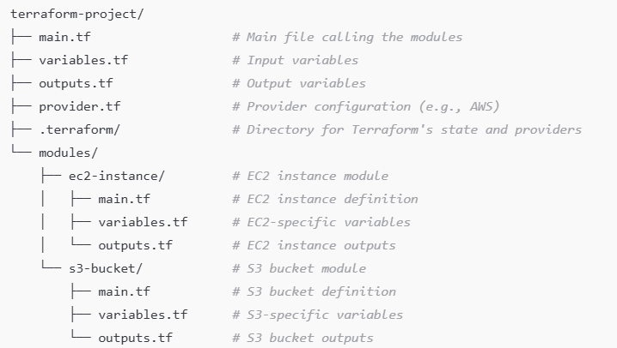
Terraform Tree
Terraform tree refers to the visualization or structure of the resources, modules, and dependencies within a Terraform configuration.
How Terraform Tree Looks (Conceptually):
Imagine you are building a project where you define multiple resources (e.g., EC2 instances, S3 buckets) and organize them into modules. Here's an example of how this structure could look as a "tree“

Slide 4
Terraform commands
terraform init:
To Initializes a Terraform configuration directory, downloading necessary provider plugins and setting up the working environment.
terraform plan:
Generates an execution plan. It shows what changes Terraform will make to your infrastructure, based on your current configuration files and state.
terraform apply:
Applies the changes to your infrastructure as defined in your configuration files. After you review the plan, this command will make the actual changes (create, update, or delete resources).
terraform destroy:
Destroys the infrastructure managed by Terraform.

Slide 5
Creating Terraform Tree
STEP 1: Open Visual studio code and create new folder or select an existing folder.
STEP 2: In that folder again create a new folder and provide one name for the folder.
STEP 3: After creating a new folder again create a new folder in that folder create a new file for VPC, Subnets, Security groups, Internet gateway and NAT gateway.

Slide 6
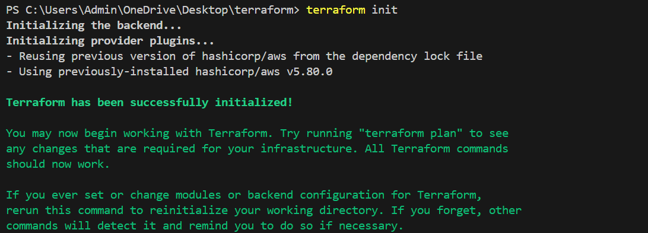
Creating VPC and Subnets Using Terraform
provider "aws" {
region = "eu-west-1"
}
resource "aws_vpc" "vpc1" {
cidr_block = "10.0.0.0/16"
tags = {
Name = "VPC1"
}
}
resource "aws_subnet" "subnet1" {
vpc_id = aws_vpc.vpc1.id
cidr_block = "10.0.1.0/24"
availability_zone = "eu-west-1a"
tags = {
Name = "Subnet-VPC1"
}
}
resource "aws_vpc" "vpc2" {
cidr_block = "12.0.0.0/16"
tags = {
Name = "VPC2"
}
}
resource "aws_subnet" "subnet2" {
vpc_id = aws_vpc.vpc2.id
cidr_block = "12.0.1.0/24"
availability_zone = "eu-west-1b"
tags = {
Name = "Subnet-VPC2"
}
}
STEP4: Create a new file in VPC Peering folder.
Here I have created a new file and named it as main.tf
STEP5: Paste the following code in the file and open
The New Terminal
STEP6: Then do the aws Configure and do the
terraform init

Slide 7
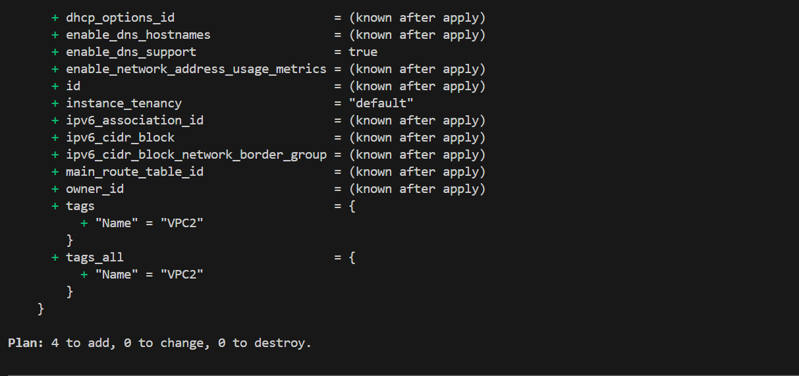
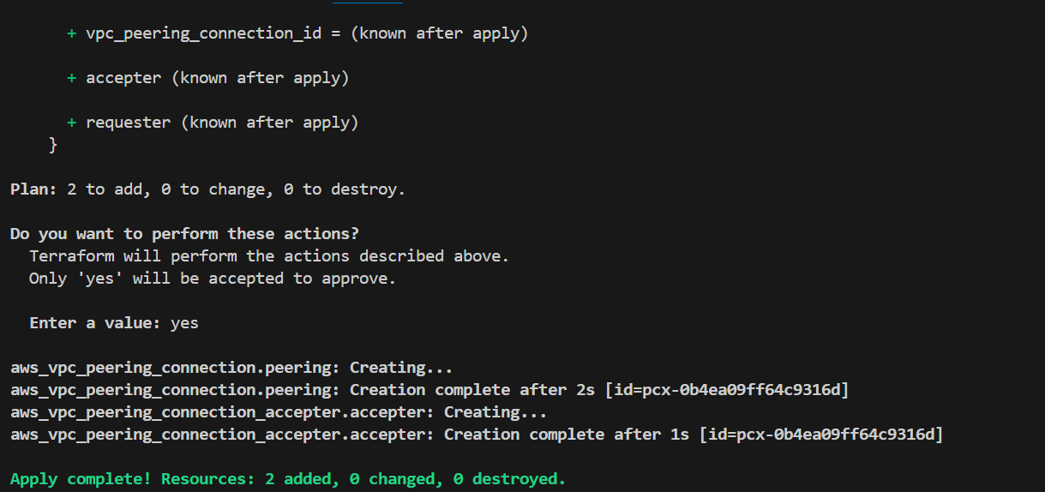
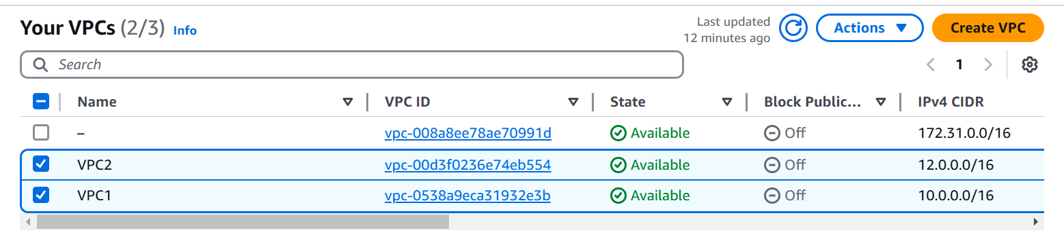
terraform plan
terraform apply
VPC Console Output

Slide 8
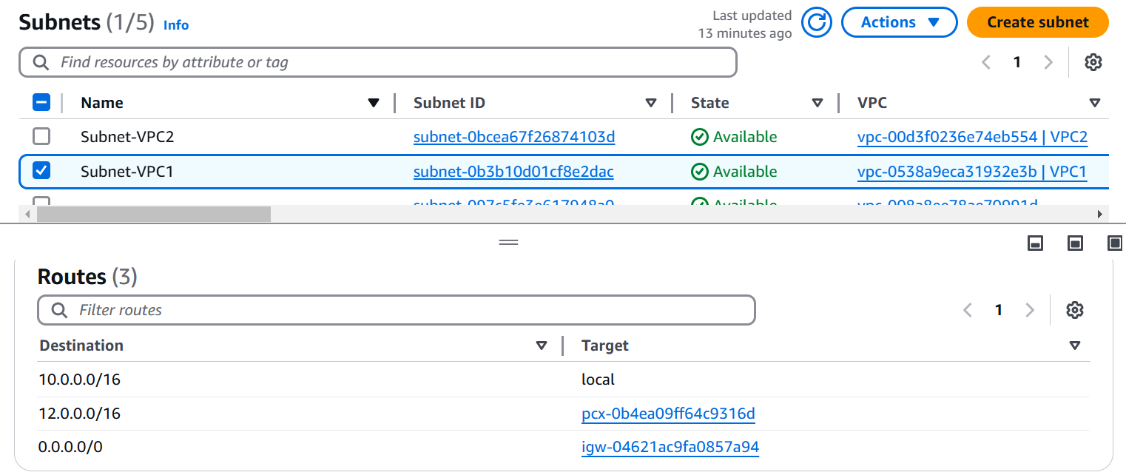
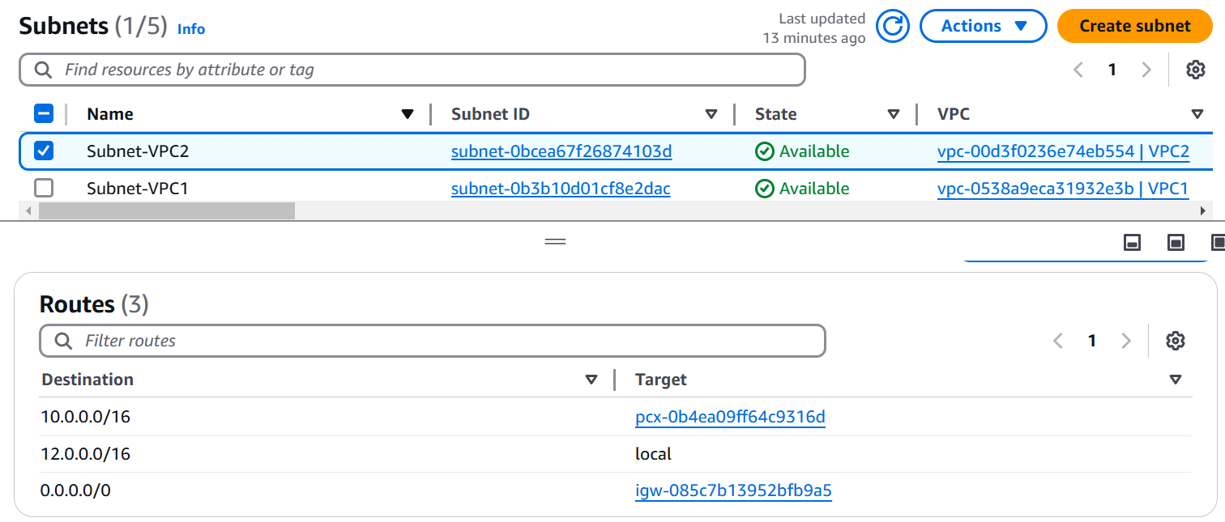
Subnet-1
Subnet-2

Slide 9
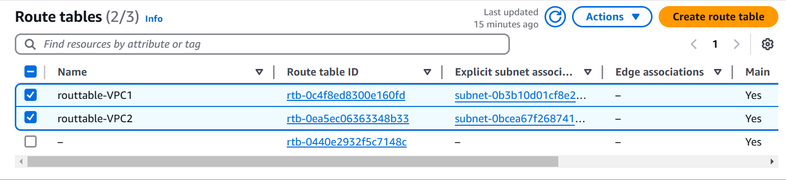
Creating Route Tables Using Terraform
resource "aws_route_table" "route_table_vpc1" {
vpc_id = aws_vpc.vpc1.id
tags = {
Name = "routtable-VPC1"
}
}
resource "aws_route_table" "route_table_vpc2" {
vpc_id = aws_vpc.vpc2.id
tags = {
Name = "routtable-VPC2"
}
}
resource "aws_route" "route_to_vpc2" {
route_table_id = aws_route_table.route_table_vpc1.id
destination_cidr_block = aws_vpc.vpc2.cidr_block
vpc_peering_connection_id = aws_vpc_peering_connection.peering.id
}
resource "aws_route" "route_to_vpc1" {
route_table_id = aws_route_table.route_table_vpc2.id
destination_cidr_block = aws_vpc.vpc1.cidr_block
vpc_peering_connection_id = aws_vpc_peering_connection.peering.id
}
resource "aws_route_table_association" "subnet1_association" {
subnet_id = aws_subnet.subnet1.id
route_table_id = aws_route_table.route_table_vpc1.id
}
resource "aws_route_table_association" "subnet2_association" {
subnet_id = aws_subnet.subnet2.id
route_table_id = aws_route_table.route_table_vpc2.id
}
STEP7: Again, Create a new file in VPC Peering.
Here I have created a new file and named it as
Routtable.tf
STEP8: Paste the following code in the file and open
The New Terminal
STEP9: Then do the terraform init, terraform plan and
terraform apply

Slide 10
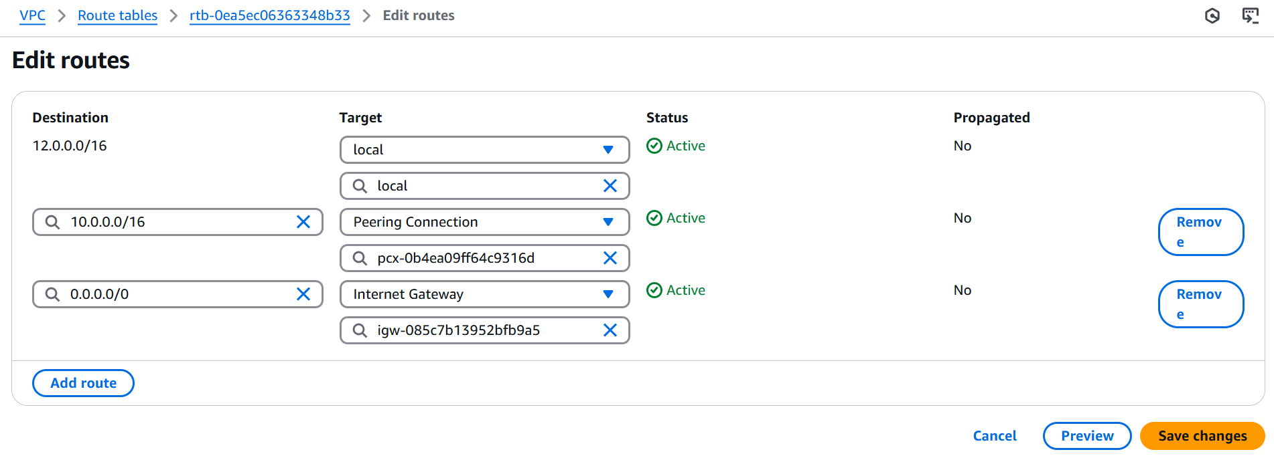
Route Table Association

Slide 11
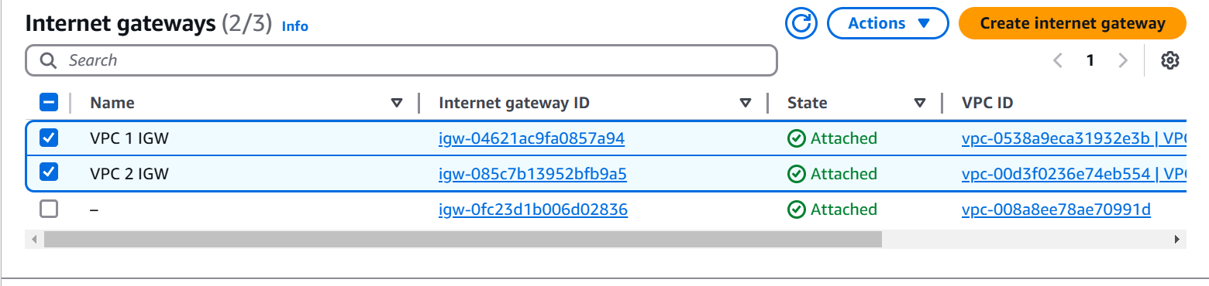
Creating INTERNET GATEWAY Using Terraform
STEP10: Again, Create a new file in VPC Peering.
Here I have created a new file and named it as IGW.tf
STEP11: Paste the following code in the file and open
The New Terminal
STEP12: Then do the terraform init, terraform plan and
terraform apply
resource "aws_internet_gateway" "vpc1_igw" {
vpc_id = aws_vpc.vpc1.id
tags = {
Name = "VPC 1 IGW"
}
}
resource "aws_internet_gateway" "vpc2_igw" {
vpc_id = aws_vpc.vpc2.id
tags = {
Name = "VPC 2 IGW"
}
}
resource "aws_route" "route_to_vpc1_igw" {
route_table_id = aws_route_table.route_table_vpc1.id
destination_cidr_block = "0.0.0.0/0"
gateway_id = aws_internet_gateway.vpc1_igw.id
}
resource "aws_route" "route_to_vpc2_igw" {
route_table_id = aws_route_table.route_table_vpc2.id
destination_cidr_block = "0.0.0.0/0"
gateway_id = aws_internet_gateway.vpc2_igw.id
}

Slide 12
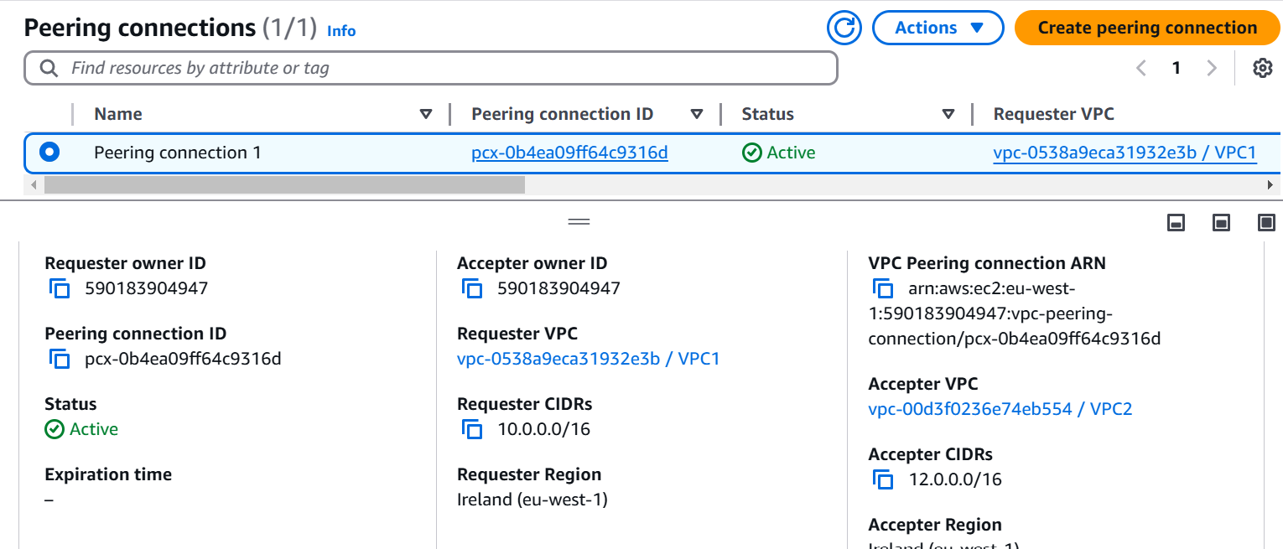
VPC Peering
VPC Peering is a way to connect two different Virtual Private Clouds
(VPCs) in AWS, allowing them to communicate with each other as if they
were in the same network.
STEP13: Again, Create a new file in VPC Peering.Here I have created a
new file and named it as Peering.tf
STEP14: Paste the following code in the file and open The New Terminal
STEP15: Then do the terraform init, terraform plan and terraform apply
resource "aws_vpc_peering_connection" "peering" {
vpc_id = aws_vpc.vpc1.id
peer_vpc_id = aws_vpc.vpc2.id
auto_accept = true
tags = {
Name = "Peering connection 1"
}
}
provider "aws" {
alias = "accepter"
region = "eu-west-1"
}
resource "aws_vpc_peering_connection_accepter" "accepter" {
provider = aws.accepter
vpc_peering_connection_id = aws_vpc_peering_connection.peering.id
}

Slide 13
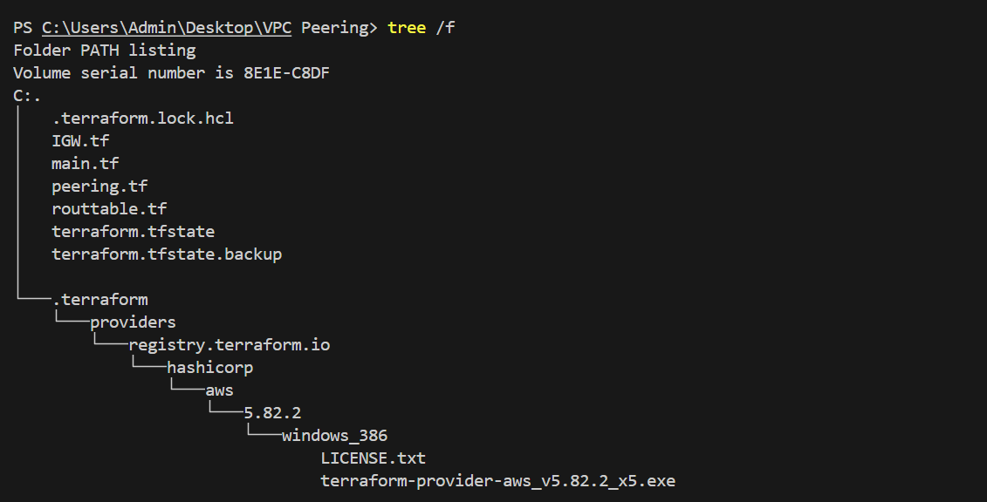
Terraform Tree Structure

Slide 14
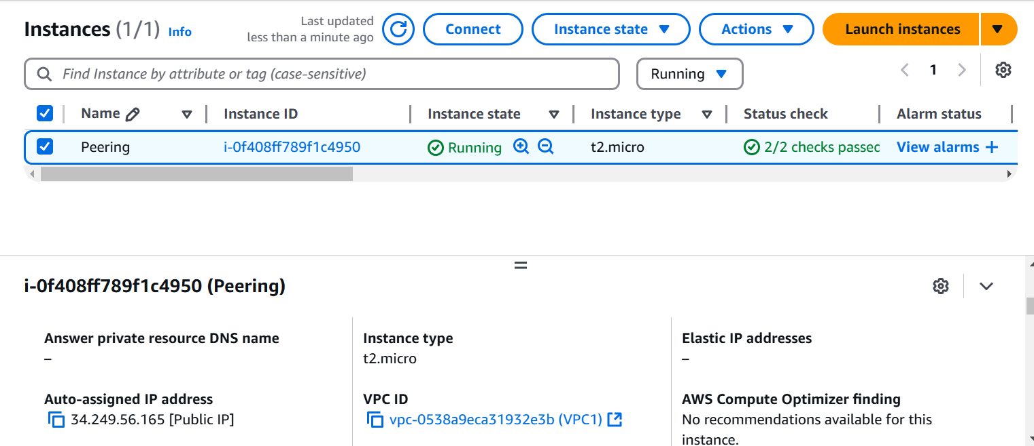
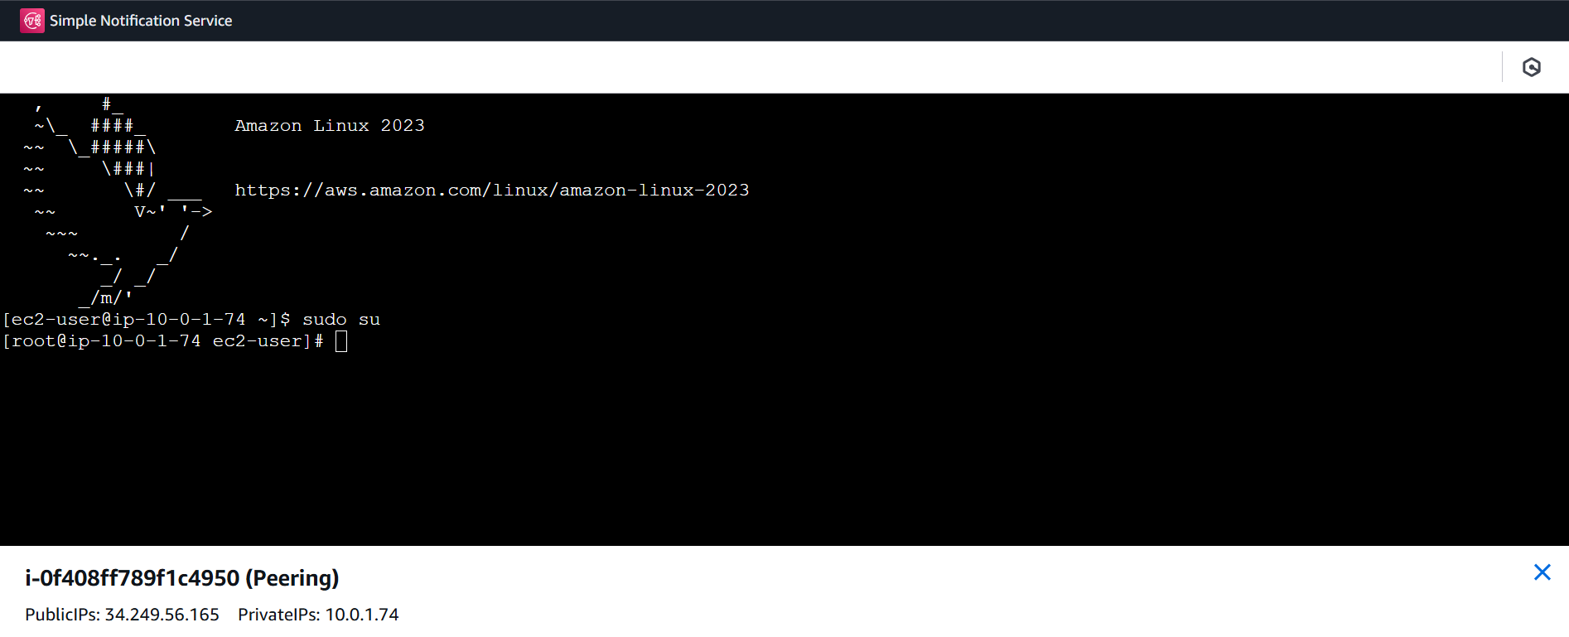
EC2 Creation using VPC’s that we have created
While creating EC2 instance IN network settings we need to modify the VPC and
Subnets and Created EC2 Instance
Checked whether it is working or not

Slide 15
Conclusion: By using VPC Peering we have connected two different Virtual Private Clouds (VPCs) in AWS, allowing them to communicate with each other as if they were in the same network.

Slide 16


